Slide 1
Document Scanning USING open.cv
Notes:
© Copyright Showeet.com – Creative & Free PowerPoint and Google Slides Templates

Slide 2
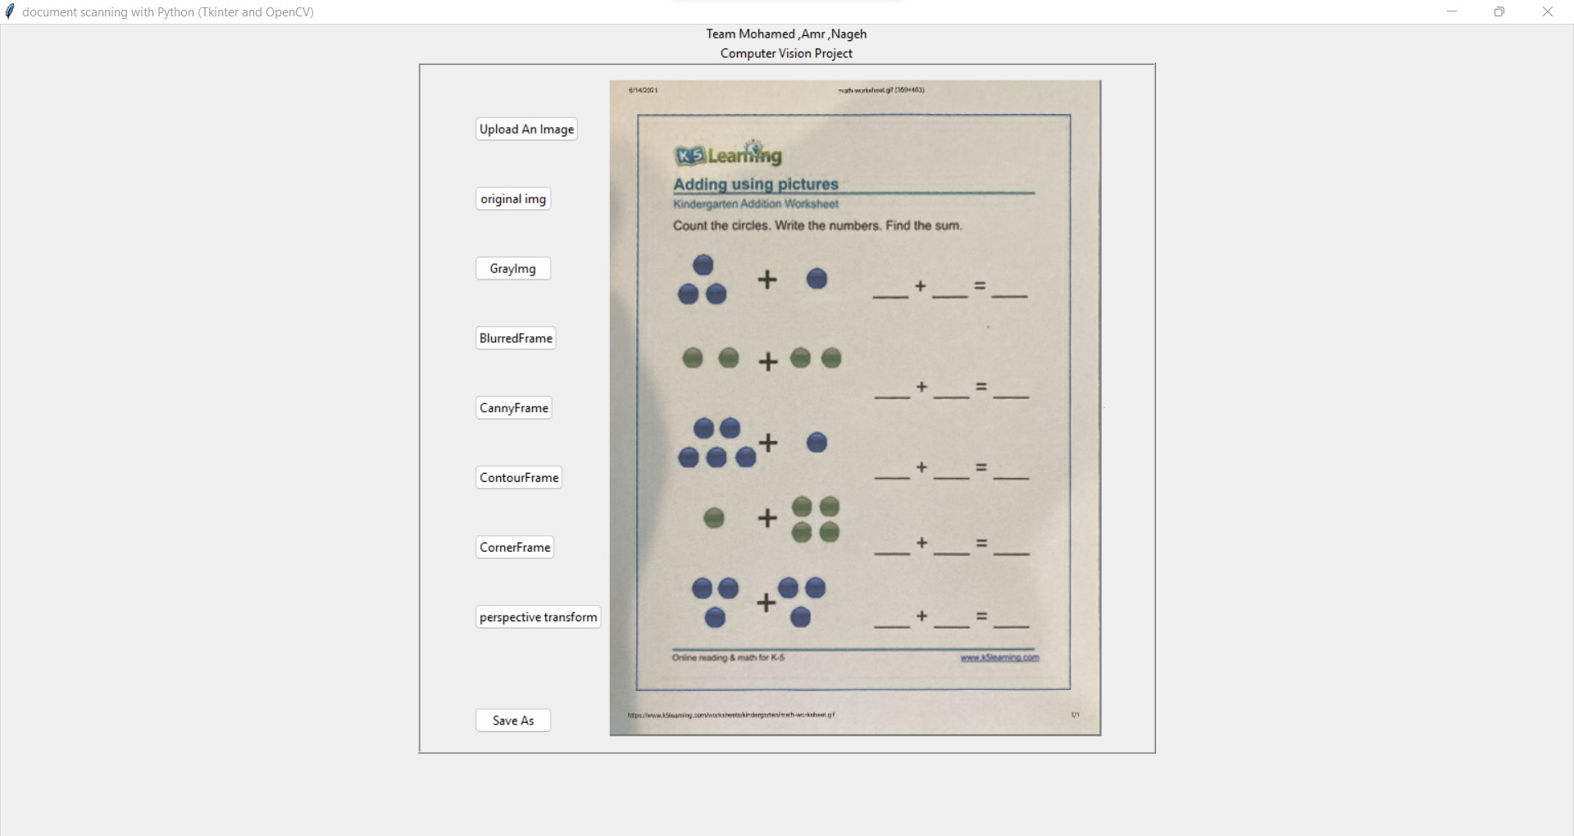
TEAM MEMBERS :
MOHAMED EID 191060040
AMR MOHAMED 191060093
AHMED NAGEH 191060127
GAMAL ALI 191060082
Notes:
© Copyright Showeet.com – Creative & Free PowerPoint and Google Slides Templates

Slide 3
Document Scanning
Doc scanner systems facilitate the initial input, storage, retrieval, and display of digital images. Specialized image processing systems additionally provide for image enhancement, image restoration, image analysis, image compression, and image synthesis. Image enhancement activities include, for example, sharpening edges and adjusting contrast. Restoration activities, like photometric correction, adjust images to compensate for conversion errors. Image analysis may extract features or classify objects within an image, while image compression concerns itself with decreasing the overall size of a digital image file. Finally, image synthesis may incorporate activities like visualization and image mergers. Scanning software may incorporate features of an image processing system for user convenience and effectiveness
Notes:
© Copyright Showeet.com – Creative & Free PowerPoint and Google Slides Templates

Slide 4
there is hardly any need for physical paperwork. Still, in the rare cases where physical documents are still required, it is necessary that we have a medium to convert them to digital documents. Thankfully for that, we don’t need the traditional hardware scanners anymore that take up a lot of space and are slow at processing documents.
Notes:
© Copyright Showeet.com – Creative & Free PowerPoint and Google Slides Templates

Slide 5
There are numerous software solutions and apps available to do just that. With the power of computer vision, the process of going from a physical to a scanned document is not very different from pointing a camera at the document and clicking a pic. The speed and ease of use are the main advantages of such solutions, and they are available for computers and mobile devices.
Notes:
© Copyright Showeet.com – Creative & Free PowerPoint and Google Slides Templates

Slide 6
Let us see how a simple OpenCV Document Scanner can be created using classical computer vision techniques, where the input will be an image of the document that we want to scan, and the expected output will be a properly aligned scanned image of the document.
Notes:
© Copyright Showeet.com – Creative & Free PowerPoint and Google Slides Templates

Slide 7
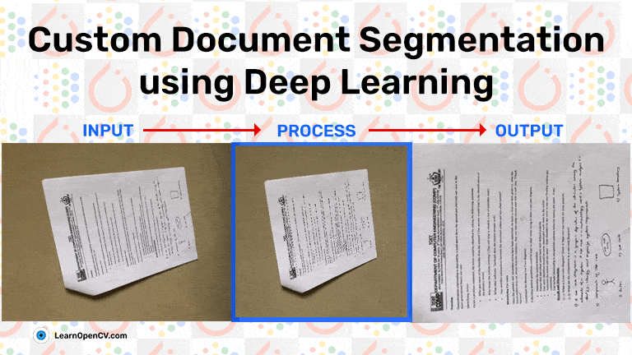

Notes:
© Copyright Showeet.com – Creative & Free PowerPoint and Google Slides Templates

Slide 8
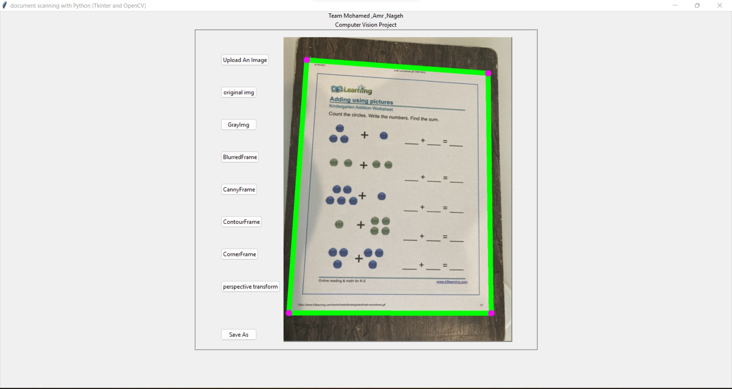
The working of doc scanner involves following steps and ways:
a). Select Image.
b). Scan the Image
c). Save the Scanned Image
d). Recognize Text
e). Save the Output Text
Notes:
© Copyright Showeet.com – Creative & Free PowerPoint and Google Slides Templates

Slide 9
Notes:
© Copyright Showeet.com – Creative & Free PowerPoint and Google Slides Templates

